Slide 1
PROGRAM APLIKASI KUIS
Made by :
Angeline Carolina - 825210138
Jeffrey Alexander - 825210120
Meili Christabel - 825210143
Winson Hosea - 825210123
Salim Santoso - 825210117

Slide 2
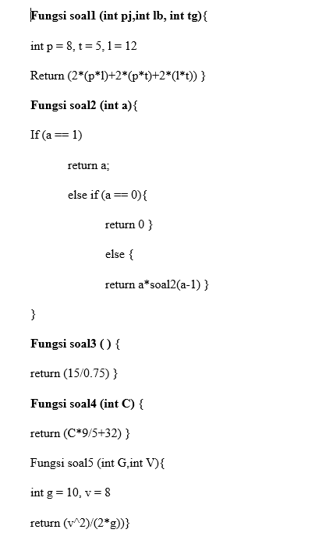
PSEUDOCODE PROGRAM KUIS

Slide 3
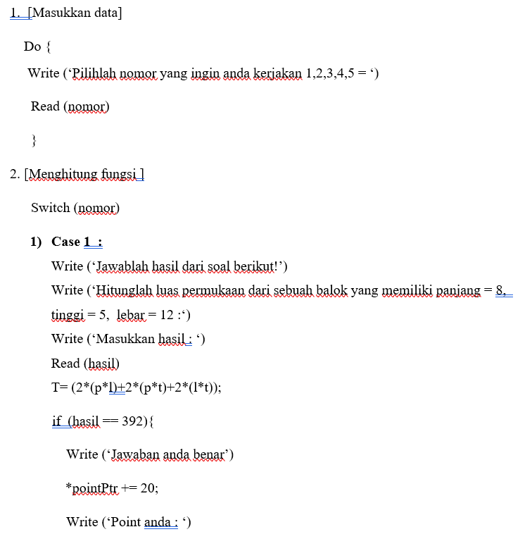
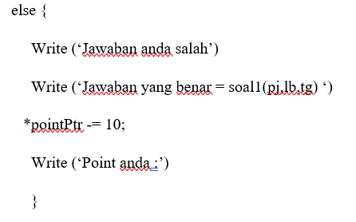
ALGORITMA UTAMA

Slide 4
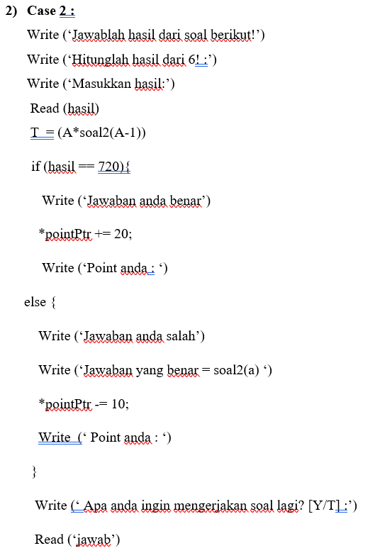


Slide 5
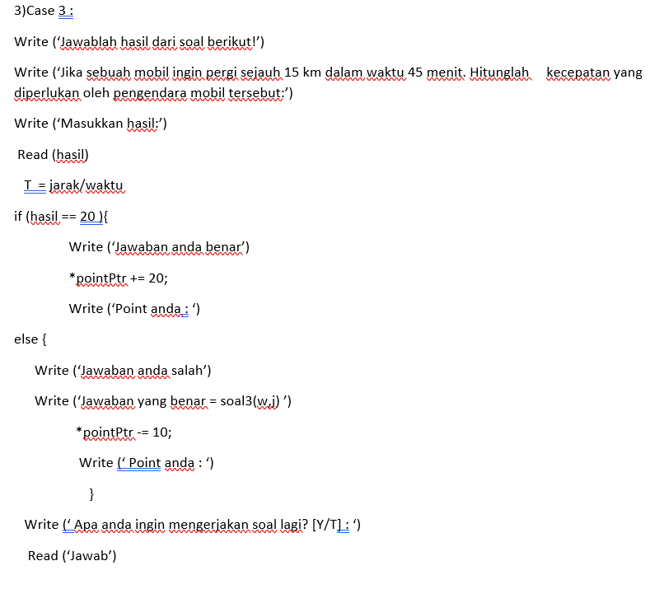
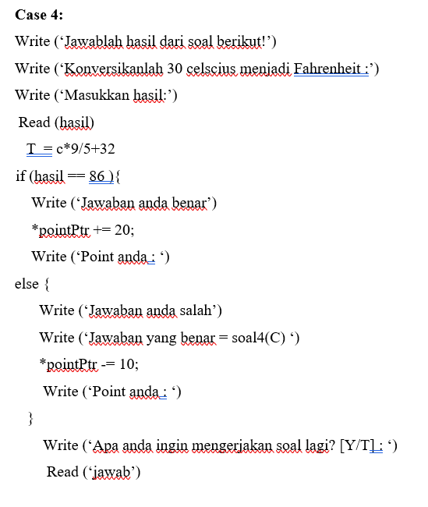

Slide 6
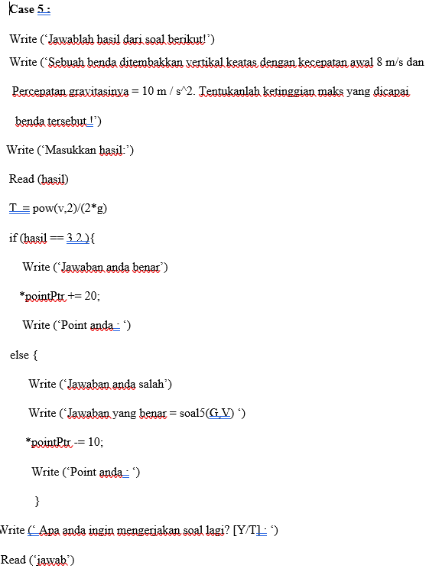
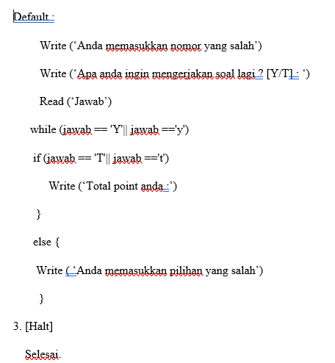

Slide 7
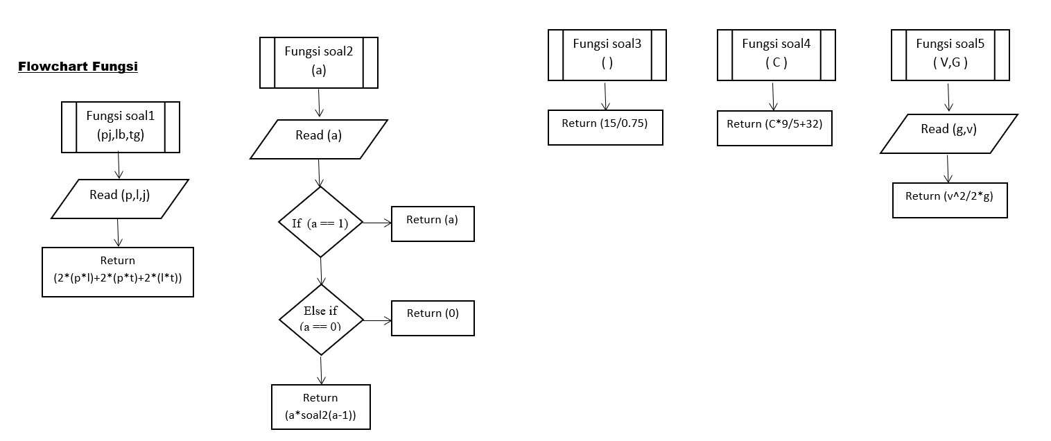
FLOWCHART FUNGSI

Slide 8
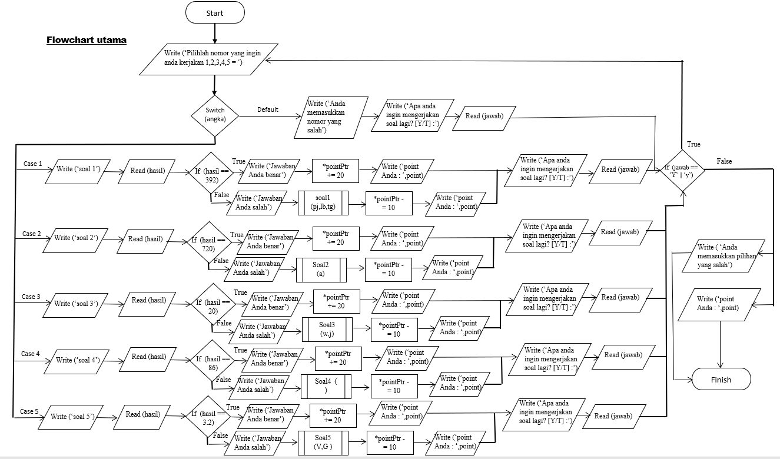
FLOWCHART UTAMA

Slide 9
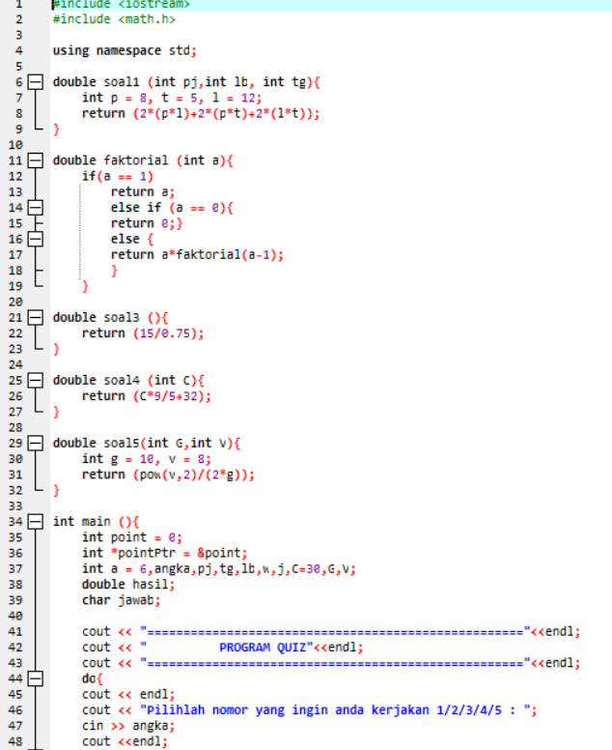
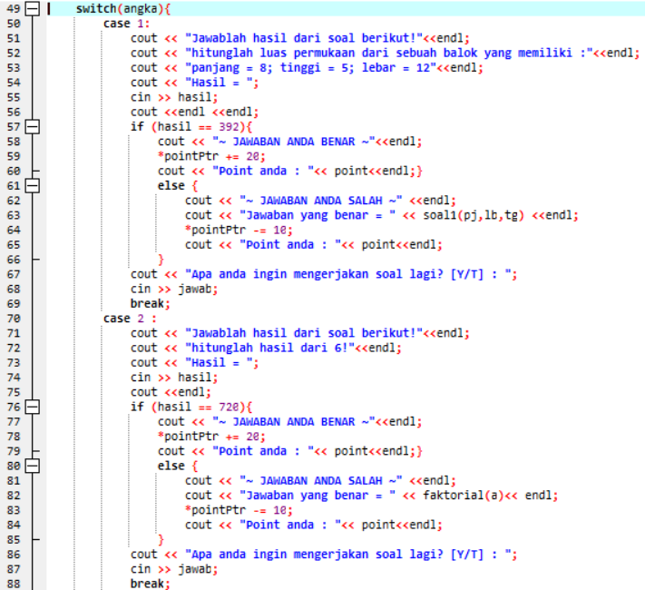
SOURCE CODE

Slide 10
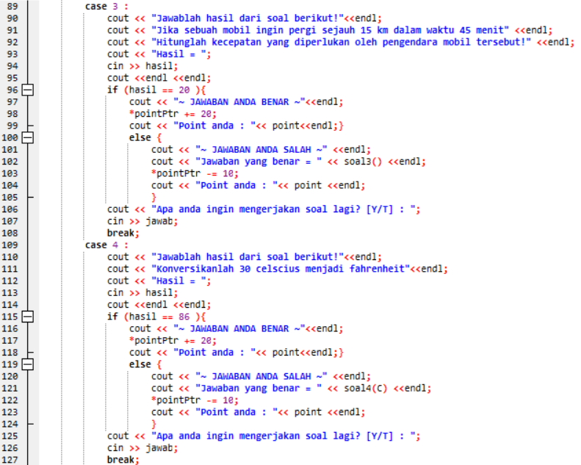

Slide 11
